Slide 1
IT5005 Artificial Intelligence
Lecture 0: Introduction

Slide 2

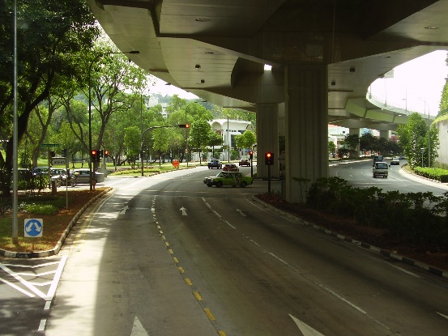

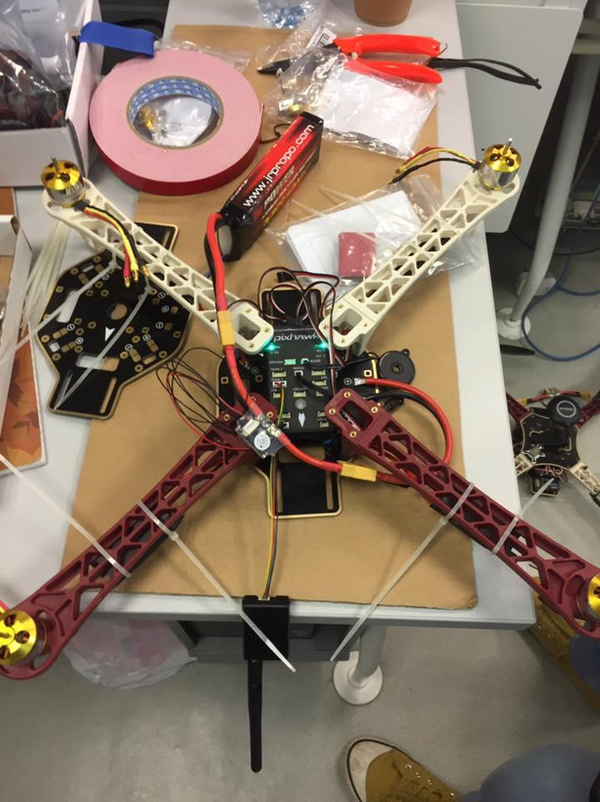
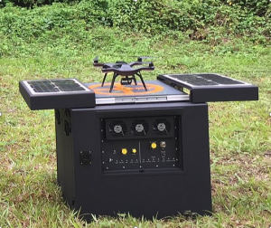
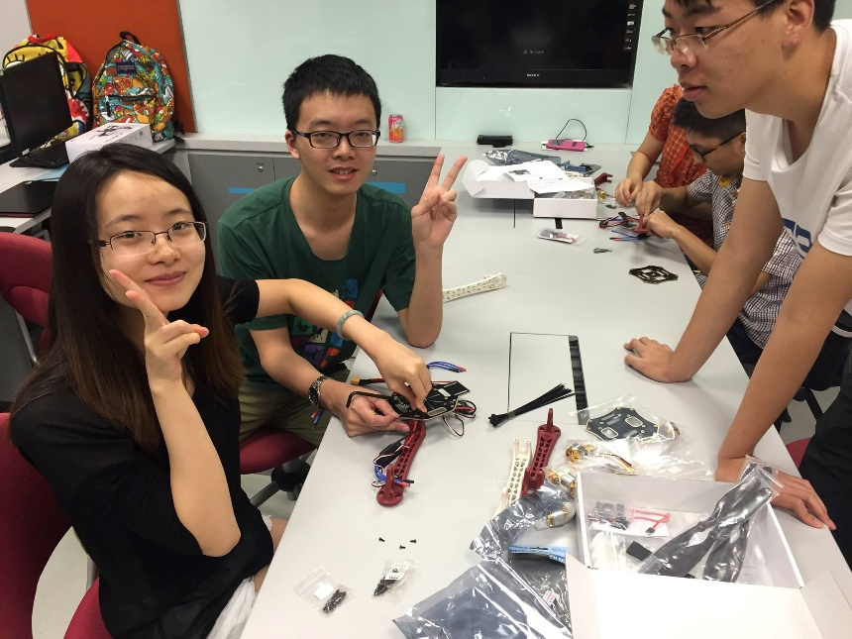
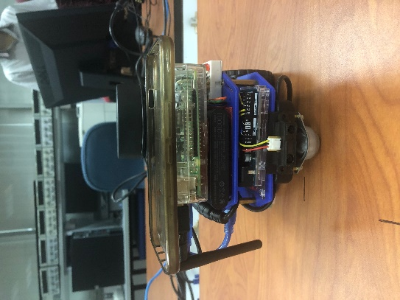

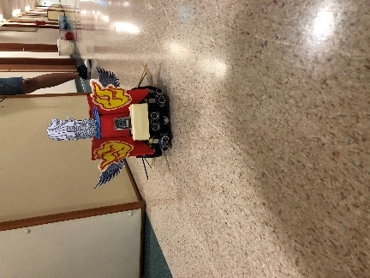
0.1 Administrivia
Colin Tan
Consultation:
Mondays 9 am to 11 am
COM2-02-08
Email: colintan@nus.edu.sg
Admin appointments:
Chief Randomness Generator,
Makers@SoC
Chairperson, Rosetta,
The NUS Special Interest Group in Artificial Intelligence, Data Science and Analytics

Slide 3
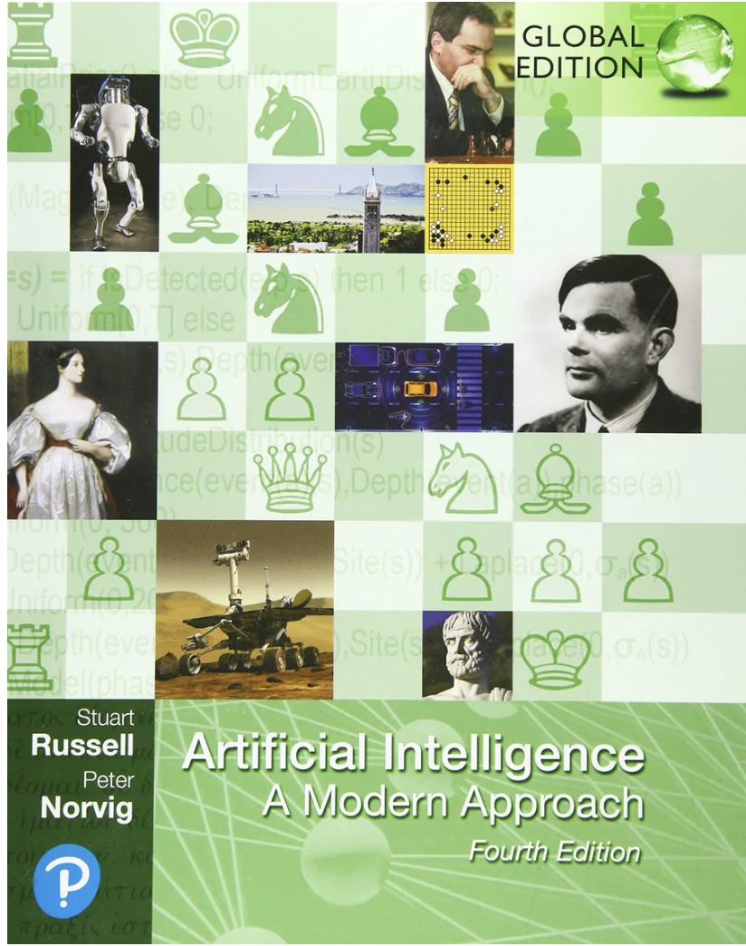
0.1 Administrivia
Textbook:
Artificial Intelligence: A Modern Approach (4th Edition)
Stuart Russell, Peter Norvig
Pearson Education.
We will not cover the entire book, but you’ll learn a ton from reading it yourselves.

Slide 4
0.1 Administrivia
Lectures:
Every Tuesday, 2 pm to 4 pm. COM1-02-06.
Tutorials:
Every Tuesday, 4 pm to 5 pm. Venues TBA.
Note: NO LABS! Information shown is incorrect.
Course Structure:
Tutorial attendance: 5%
Mid-term: 20%
Assignment (~Week 7): 20%
Final Exam: 55%

Slide 5
0.1 Administrivia
Important Dates (Please keep free!)
Midterm Test: Monday 11 March 2024, 7 pm to 8 pm, Open-Book, handwritten.
If you have existing non-academic arrangements, please either change them or drop IT5005.
Final Assessment: Tuesday 30 April 2024, 1 pm to 3 pm, Open-Book, Examplify
As per NUS policies, there will be no make-up for Final Assessments. If you miss it (including being sick), you may need to retake IT5005.

Slide 6

0.2 What is Artificial Intelligence?
This is a class on Classical Artificial Intelligence, NOT MACHINE LEARNING.
We will cover:
Propositional Logic
Predicate Logic
Informed and Uninformed Search Algorithms
Neural Networks (very basic)
Reasoning with Uncertainty
Constraint Satisfaction Problems
Reinforcement Learning.
If you are here to learn about Machine Learning, you are in the wrong place!

Slide 7
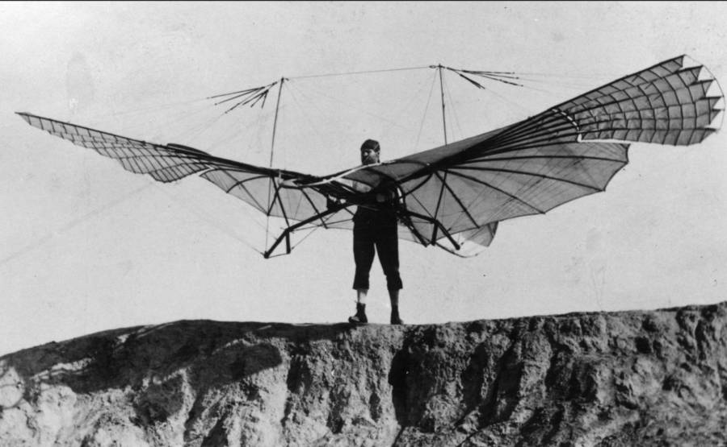

0.2 What is Artificial Intelligence?
Artificial Intelligence (AI) is the science (and art?) of making computing machines as good as humans in performing human tasks:
Though not necessarily the same way; airplanes and birds both fly, but differently.
Techniques have to be adapted to particular quirks:
Human thought processes are extremely complex and handled by billions of simultaneous neural connections.
Computers are excellent at doing computations extremely quickly.

Slide 8
0.2 What is Artificial Intelligence?
Think like a human
Think rationally
Act like a human
Act rationally

Slide 9
0.2 What is Artificial Intelligence?
Linguistics
CS
AI
Philosopy
Math
Psychology
Economics

Slide 10
0.2 What is Artificial Intelligence?
Philosophy
Ethics
Logic
Learning
Rationality
Computer Science
Theory of Computing
Hardware
Control Theory
Dynamic Systems
Mathematics
Formal representation
Probability
Statistics
Theory of the Mind
Economics
Game theory
Decision theory
Fair Division
Psychology
Perception and motor control
Experiments
Linguistics
Knowledge representation
grammar
Utility theory

Slide 11
0.3 Rational Agents
Rational agents and their (specific) attributes.
Task environment specification
Environment characteristics
Categories of agents
Exploration vs. exploitation

Slide 12
0.3 Rational Agents
Rational behavior: doing the “right thing”
What is the “right thing” to do? Expected to achieve best outcome
Best for whom?
What are we optimizing?
What information is available?
Unintended effects
Break through wall to get a cup of coffee
Prescribe high doses of opiates to depressed patient
kill human who tries to deactivate robot
Notes:
1. We will formalize this later.
3. More general than “Laws of Thought” approach.

Slide 13
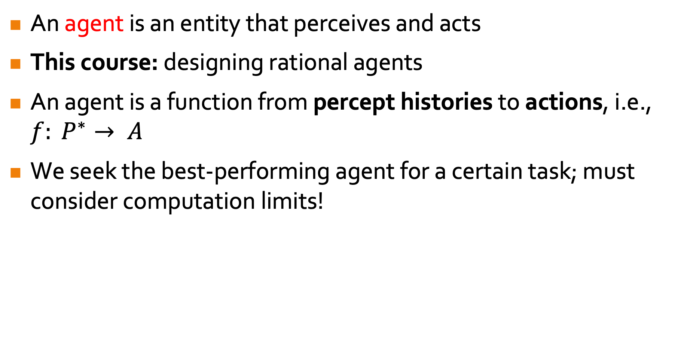
0.3 Rational Agents
An agent is an entity that perceives and acts
This course: designing rational agents
An agent is a function from percept histories to actions, i.e., $f: P^{∗}→ A$
We seek the best-performing agent for a certain task; must consider computation limits!
design best program given resources
Notes:
4. What other problems do u foresee if such a rational agent is tasked to interact with humans?

Slide 14
0.3 Rational Agents
Anything that can be viewed as perceiving its environment through sensors; acting upon that environment through actuators
Human agent: eyes, ears, skin etc. are sensors; hands, legs, mouth, and other body parts are actuators
Robotic agent: cameras and laser range finders for sensors; various motors for actuators

Slide 15
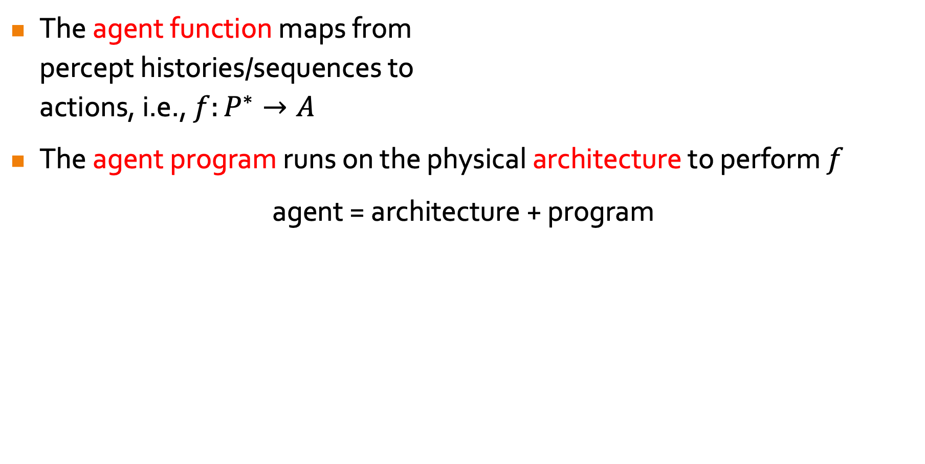
0.3 Rational Agents
The agent function maps from percept histories/sequences to actions, i.e., $f:P^{∗}→A$
The agent program runs on the physical architecture to perform $f$
agent = architecture + program
Notes:
1. Must know percept (sensing input), percept sequence, action
2(a) Think of function as the math, and program as code to implement f
(b) Architecture = physical computing device with physical sensors and actuators
(c) How can we design the agent program?

Slide 16

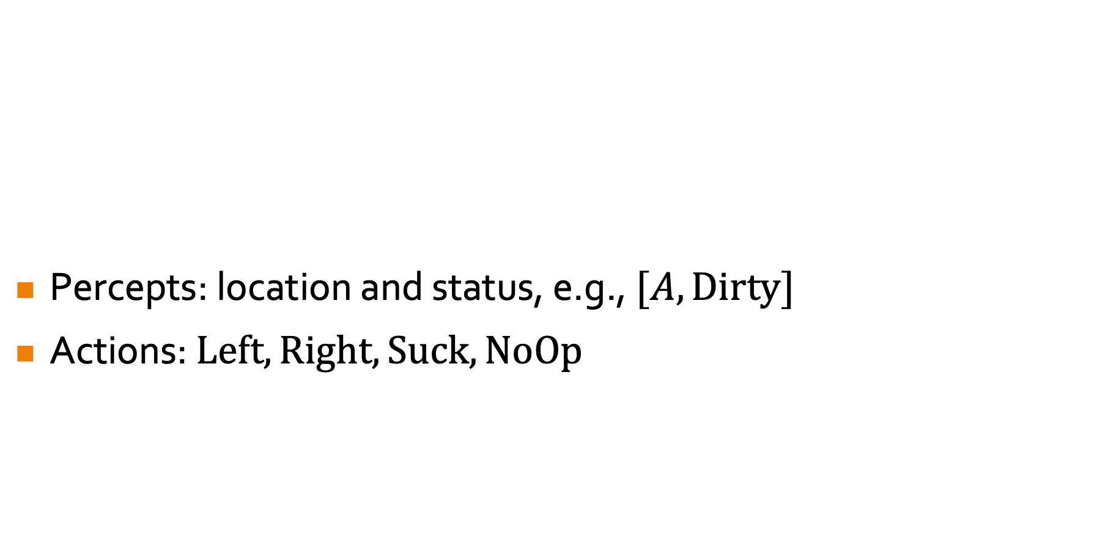
0.3 Rational Agents
Percepts: location and status, e.g., $[A, Dirty]$
Actions: $Left, Right, Suck, NoOp$
Notes:
1(a) 2 locations A & B
1(b) The robot knows which square it is in and see whether there is dirt in its square.
2. NoOp = Do nothing

Slide 17
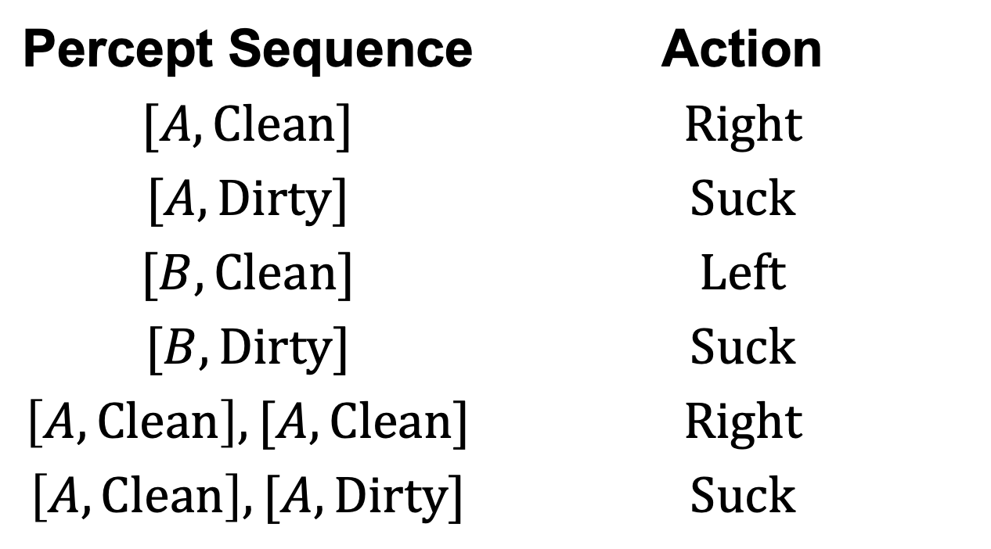
0.3 Rational Agents
Percept Sequence | Action
$$[A, Clean]$$ | $$Right$$
$$[A, Dirty]$$ | $$Suck$$
$$[B, Clean]$$ | $$Left$$
$$[B, Dirty]$$ | $$Suck$$
$$\left[A, Clean\right],[A, Clean]$$ | $$Right$$
$$\left[A, Clean\right],[A, Dirty]$$ | $$Suck$$
Notes:
1. Tabulating agent function: infinite entries unless bound length of percept sequence
2. Naive way of designing agent program? if then else statements
3. Worst case: inspect number of percept sequences exponential in length.
3. In later slides, we will look to simplify agent program for tractability

Slide 18
0.3 Rational Agents
An agent should strive to “do the right thing”, based on what it can perceive and the actions it can perform. The right action: maximize agent success.
Performance measure: objective criterion for measuring success of an agent's behavior
Vacuum-cleaner agent:
amount of dirt cleaned
time taken
electricity consumed
noise generated
Perhaps a bit of everything?
Notes:
Every entry of table is filled out correctly.
How do you quantify success?
Not just 1 performance measure that can be specified
Better to design performance measures based on what one actually wants in the environment, rather than based on how one thinks the agent should behave. For the latter, may outsmart you: dump dirt on floor (if action is permitted) and clean again. Solution: Reward each clean square at each time step.

Slide 19
0.3 Rational Agents
Rational Agent:
For each possible percept sequence, select an action that is expected to maximize its performance measure…
given the evidence provided by the percept sequence and whatever built-in knowledge the agent has.
Notes:
Percept sequence to date
Prior knowledge of environment

Slide 20
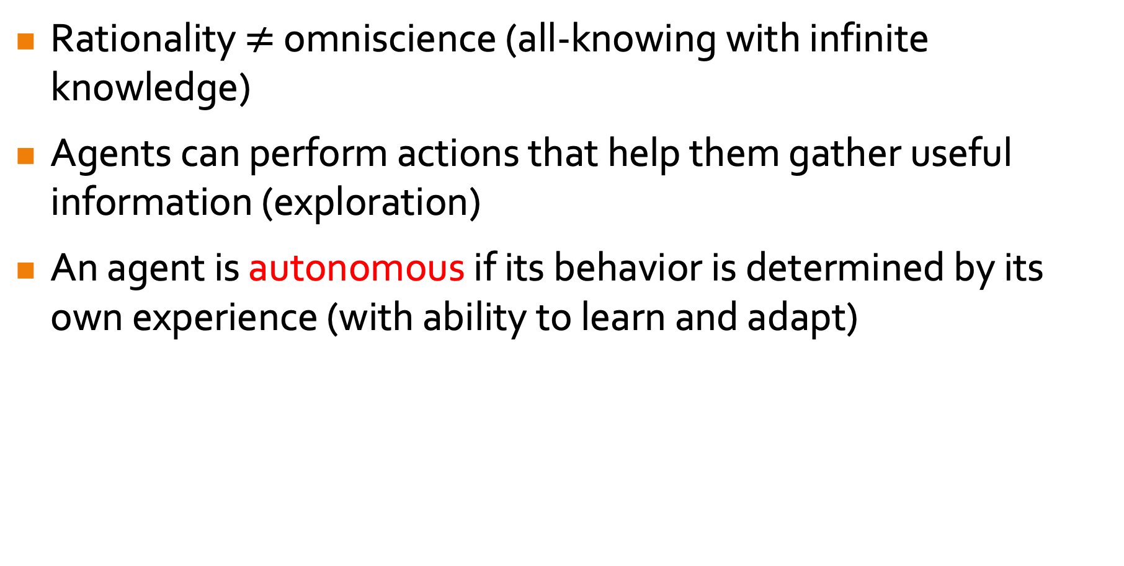
0.3 Rational Agents
Rationality $≠$ omniscience (all-knowing with infinite knowledge)
Agents can perform actions that help them gather useful information (exploration)
An agent is autonomous if its behavior is determined by its own experience (with ability to learn and adapt)
Notes:
Omniscient agent knows ACTUAL outcome of actions. (1) Rationality maximizes expected performance while perfection maximizes actual performance; (2) Rationality depends on percept sequence to date.
.
Not determined or designed by human

Slide 21
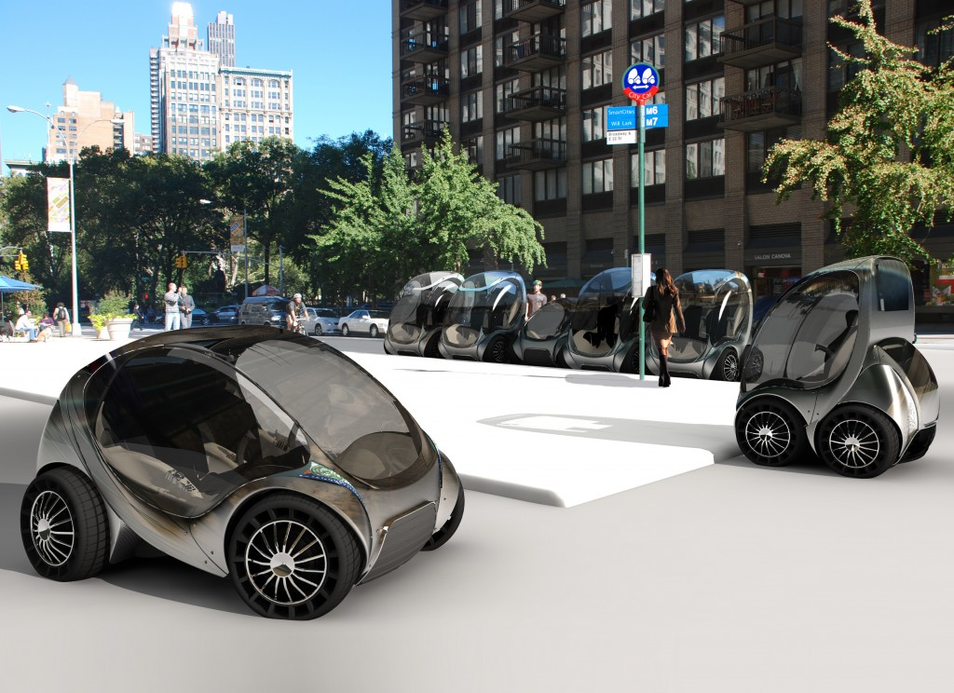
0.3 Rational Agents
PEAS: Performance measure, Environment, Actuators, Sensors
Must first specify the setting for intelligent agent design
Consider, e.g., the task of designing an automated taxi driver:
Performance measure
Environment
Actuators
Sensors
Notes:
3(a) Performance measure: some goals may conflict, thus requiring tradeoffs.
3(b) Environment: more structured/restricted, easier to design agent.

Slide 22
0.3 Rational Agents
Performance Measure
Safe
Fast
Legal
Comfort
Revenue
Environment
Roads
Other traffic
Pedestrians
Customers
Actuators
Steering wheel
Accelerator
Brake
Sensors
Signal
Horn
Camera
Sonar
Speedometer
GPS
Engine sensors

Slide 23
Properties of Task Environments
Fully observable (vs. partially observable):
sensors provide access to the complete state of the environment at each point in time.
Deterministic (vs. stochastic)
The next state of the environment is completely determined by the current state and the action executed by the agent.
Episodic (vs. sequential)
The choice of current action does not depend on actions in past episodes.
Alternatively: current action does not affect future decisions
Notes:
Categorize them along these dimensions, which determine the appropriate agent design.
Definitions here are informal; the later lectures in this course will provide more precise statements
FULLY OBSERVABLE: The sensors detect STATE = “all aspects that are relevant to the choice of action; relevance depends on perf measure”. Don’t have to maintain internal state of environment. PARTIALLY OBSERVABLE: noisy, inaccurate sensors, missing state info from sensor data. UNOBSERVABLE: no sensors.
STATE TRANSITION: STOCHASTIC: prob over next state.
EPISODIC: current action does not depend on previous actions or affect future actions. SEQUENTIAL: current action can affect all future actions.

Slide 24
Properties of Task Environments
Static (vs. dynamic)
The environment is unchanged while an agent is deliberating.
Discrete (vs. continuous)
A finite number of distinct states, percepts, and actions.
Single agent (vs. multi-agent)
An agent operating by itself in an environment.

Slide 25
Agent Functions and Programs
An agent is completely specified by the agent function mapping percept sequences to actions
One agent function (or a small equivalence class) is rational
Aim: Find a way to implement the rational agent function concisely

Slide 26
Agent Functions and Programs
Solution: write all possible percepts and optimal actions in a table.
All done!

Slide 27
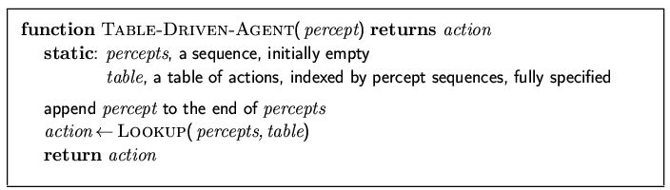
Table-Lookup Agent
Drawbacks:
Huge table to store
Take a long time to build the table
No autonomy: impossible to learn all correct table entries from experience
No guidance on filling in the correct table entries
Notes:
Suppose every percept can take 2 values and length is fixed at T, storage = sum^T_{t=1} 2^t.
.
No agent can ever learn all the correct table entries from its experiences (may not encounter some table entries).
With a very long percept history, it is hard to figure the correct action.

Slide 28
Agent Types
Four basic types in order of increasing generality:
Simple reflex agent
Model-based reflex agent
Goal-based agent
Utility-based agent
Notes:
1. From previous example, an agent often performs well even when the rest of percept history is ignored.
2. They are all reflex agents, meaning they select actions based on the current percept, ignoring rest of percept history.
3. Model-based built on top of simple, goal- and utility-based built on top of model-based.

Slide 29
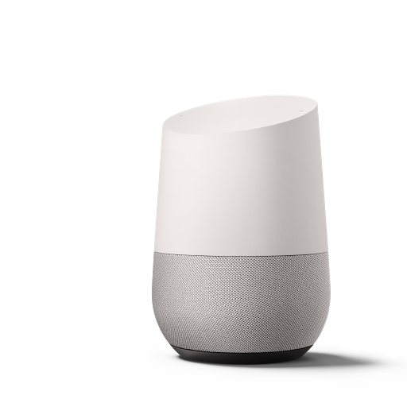
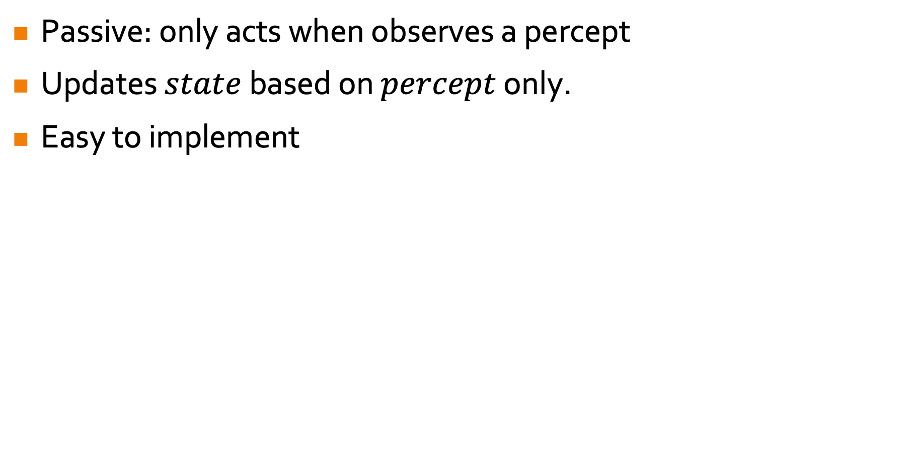
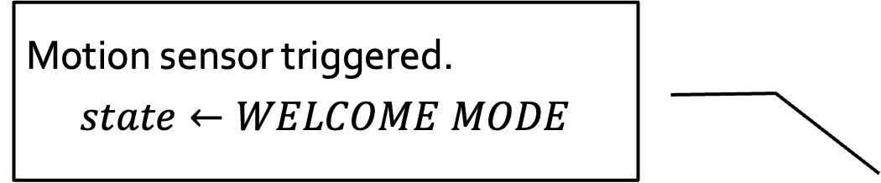
Reflex Agent
Passive: only acts when observes a percept
Updates $state$ based on $percept$ only.
Easy to implement
Motion sensor triggered.
$$state←WELCOME MODE$$
Notes:
1. From previous example, an agent often performs well even when the rest of percept history is ignored.
2. They are all reflex agents, meaning they select actions based on the current percept, ignoring rest of percept history.
3. Model-based built on top of simple, goal- and utility-based built on top of model-based.

Slide 30
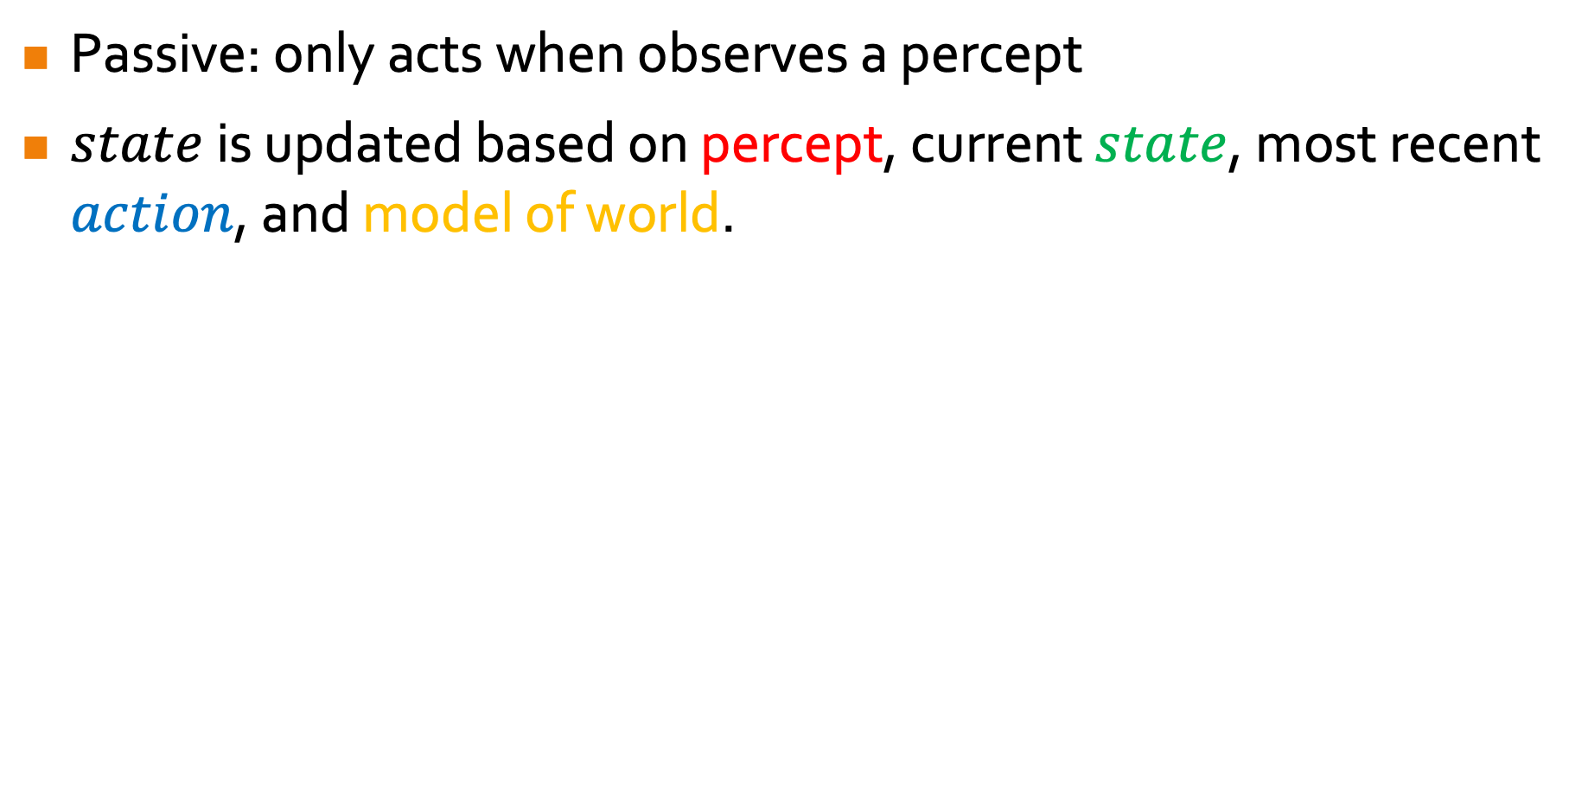
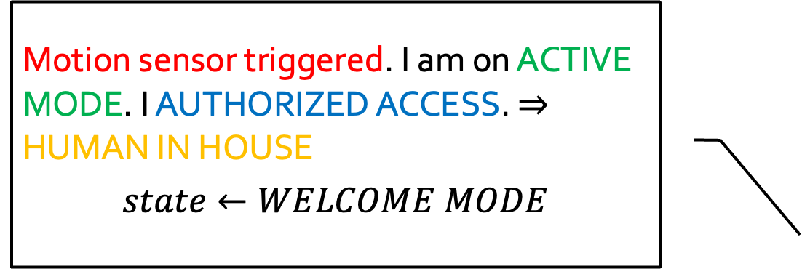
Model Based Reflex Agent
Passive: only acts when observes a percept
$state$ is updated based on percept, current $state$, most recent $action$, and model of world.
Motion sensor triggered. I am on ACTIVE MODE. I AUTHORIZED ACCESS. $⇒$ HUMAN IN HOUSE
$$state←WELCOME MODE$$
Notes:
1. From previous example, an agent often performs well even when the rest of percept history is ignored.
2. They are all reflex agents, meaning they select actions based on the current percept, ignoring rest of percept history.
3. Model-based built on top of simple, goal- and utility-based built on top of model-based.

Slide 31

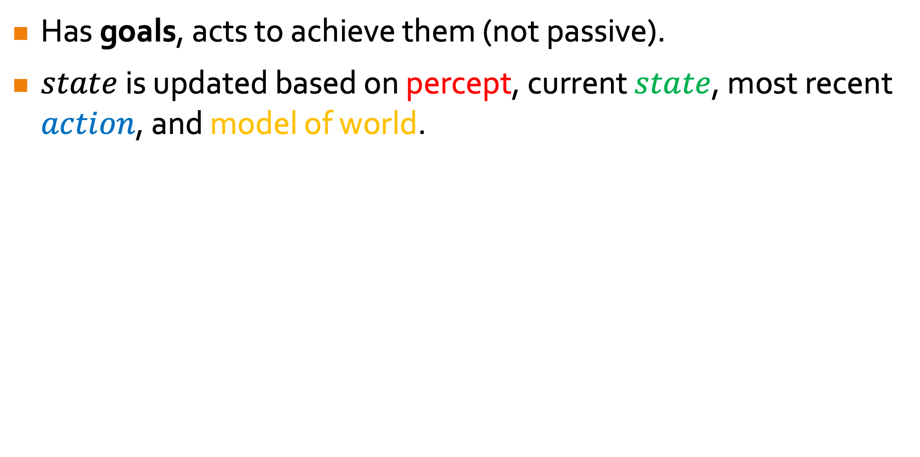
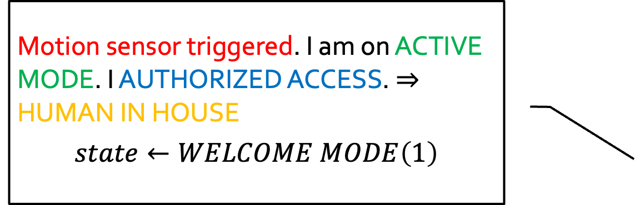
Goal Based Agent
Has goals, acts to achieve them (not passive).
$state$ is updated based on percept, current $state$, most recent $action$, and model of world.
Goal: make human happy (and buy products from my vendor)
Motion sensor triggered. I am on ACTIVE MODE. I AUTHORIZED ACCESS. $⇒$ HUMAN IN HOUSE
$$state←WELCOME MODE\left(1\right)$$
Notes:
1. From previous example, an agent often performs well even when the rest of percept history is ignored.
2. They are all reflex agents, meaning they select actions based on the current percept, ignoring rest of percept history.
3. Model-based built on top of simple, goal- and utility-based built on top of model-based.

Slide 32
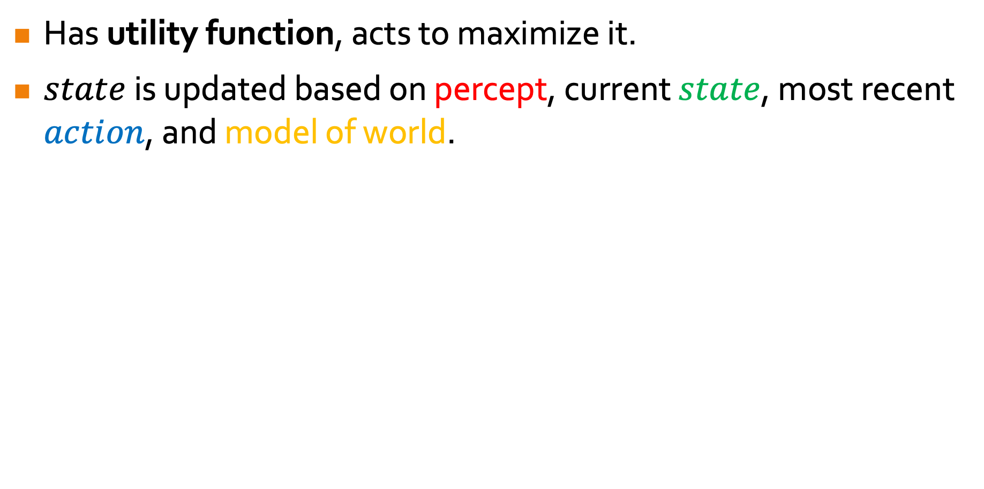
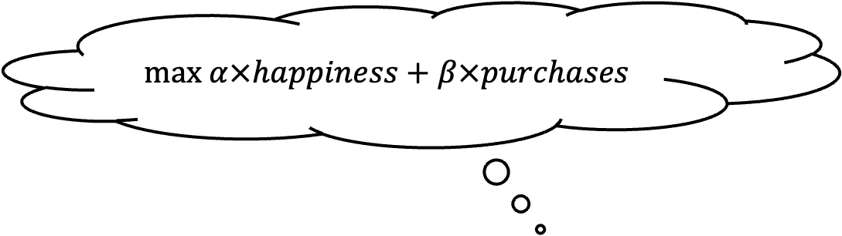
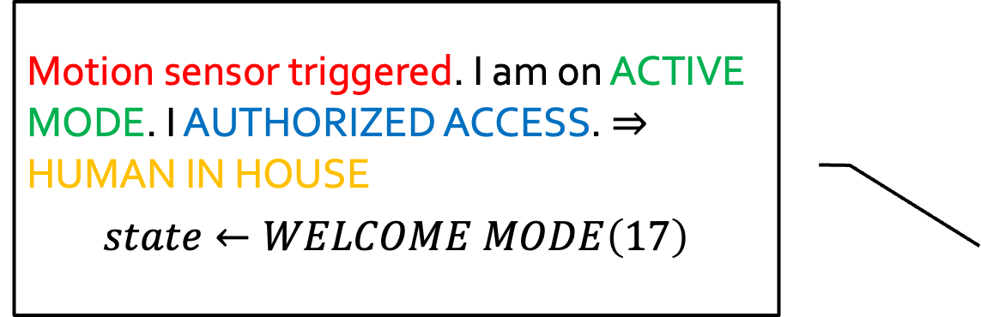
Utility Based Agent
Has utility function, acts to maximize it.
$state$ is updated based on percept, current $state$, most recent $action$, and model of world.
$$max α×happiness+β×purchases$$
Motion sensor triggered. I am on ACTIVE MODE. I AUTHORIZED ACCESS. $⇒$ HUMAN IN HOUSE
$$state←WELCOME MODE\left(17\right)$$
Notes:
1. From previous example, an agent often performs well even when the rest of percept history is ignored.
2. They are all reflex agents, meaning they select actions based on the current percept, ignoring rest of percept history.
3. Model-based built on top of simple, goal- and utility-based built on top of model-based.

Slide 33
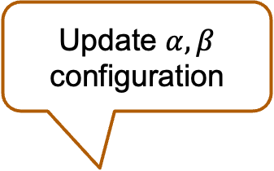
Learning Agent
Performance Standard
17 sodas is unacceptable!
Update $α,β$ configuration
Human did not like 17 sodas ☹
Critic
Learner
Problem Generator
Maybe 170 sodas this time?
Performance Element
(think the utility agent architecture from the last slide)
Notes:
0(a) Don’t program agents by hand. Make them learn.
0(b) Advantage: operate in initially unknown environments and perform better than with prior knowledge. Especially useful when designer does not have full knowledge of the env.
Perf element: Agent
Critic observes the world thru percepts

Slide 34
Exploitation vs. Exploration
An agent operating in the real world must often choose between:
maximizing its expected utility according to its current knowledge about the world; and
trying to learn more about the world since this may improve its future gains.
Exploitation vs. Exploration
Notes:
Example:
Should I drop out of school and start a tech company?
Should I try a new food stall at the canteen?
Should I marry my current partner?
Should I buy a new phone?

Slide 35
END OF FILE

